Slide 1
Hacking the SF rental market

Slide 2
Introduction
Notes:
Sf is beautiful place
Everyone want to live here
Expensive
Not a lot of options
Vacancy rate is under 3%

Slide 3
Analytics & tools
Notes:
Decided to use Craiglists because of large selection, and relatively cheaper prices, as they are usually posted by owners and tenants. For people who are more budget conastrained, and want to look for better deals
OUT of over 3000 listings that I scraped, there was only 763 unique listings

Slide 4
Analytics & tools
Linear Regression
R-Squared = .54
MSE = $852
Notes:
Model is a linear regression model (non-regularization)
Tried using more advance models
Adding polynomials
Adjusting functional forms (looking at relationships non-linearly)
Regularization
However, non of them improved the model (it actually reduce the R^2 by about .1)
MSE (23% of mean)

Slide 5
Results
Notes:
Coeff for laundry is $920 higher than anything else
Intercept is only $762
Pets and laundry on premise coeff is around $340

Slide 6
Results
Notes:
Another reason for using Area as proxy - Coeff for bed / bath are a little bit low
Larger amount of units in the 750 square ft and 950 square foot range

Slide 7
Results

Slide 8
Conclusion
Use Area (SF) as proxy
Look for laundry on premise, NOT in unit
Look for places that do not allow pets IF you don’t have any
Furnished Units / Available Parking NOT major factor
Notes:
Use Area as a starting point OR if you need a 2bdrm or 3 bdrm go for a slightly smaller place or less bathrooms

Slide 9
Future Improvements
Add More Data
Add Location As Categorical Features
Add Time Series
Tenant Buyout Prediction Model
Notes:
Tie current data to Buyout Prices
Require additional scraping to approximate # rooms, square footage, etc.
i.e. Zillow
take average rental prices based on bed/bath/area and zip code (from craiglist data), and append to the buyout listing

Slide 10
Questions?

Slide 11
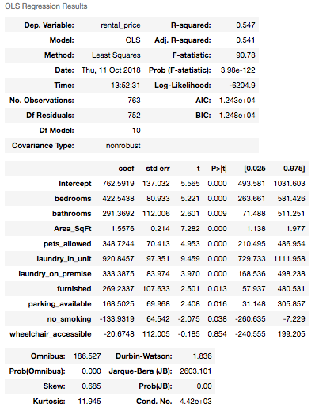
Appendix

Slide 12
Appendix

Slide 13
Appendix

Slide 14
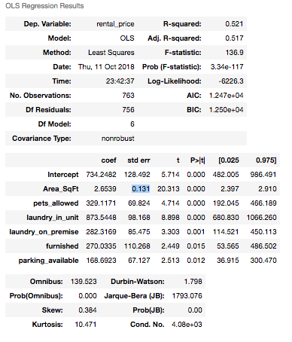
Appendix

Slide 15
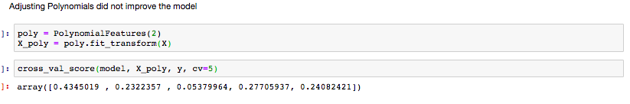
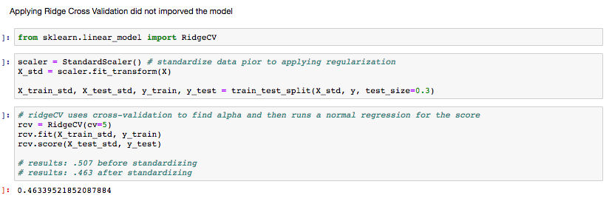
Appendix

Slide 16
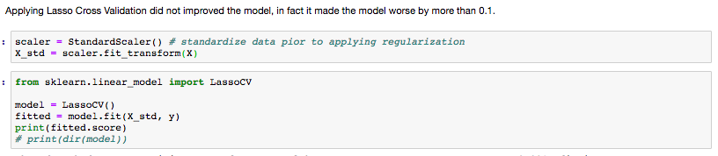
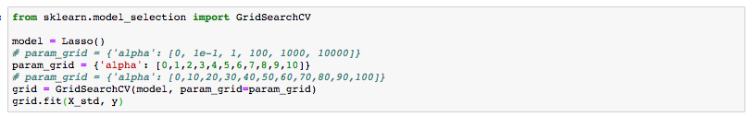
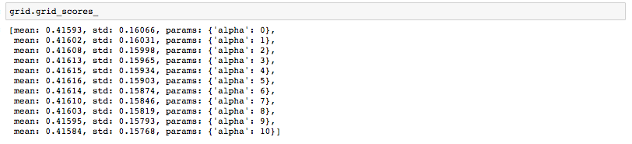
Appendix

Slide 17
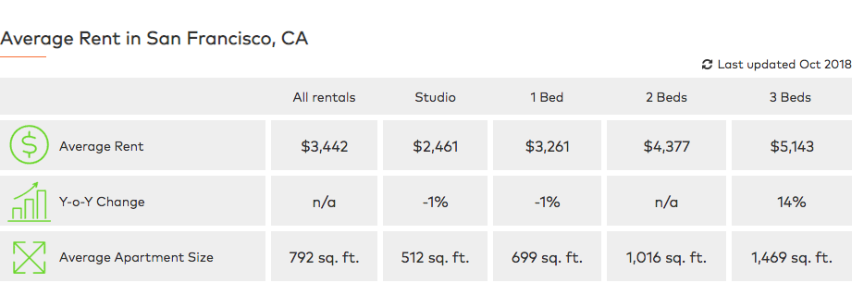
Appendix
Source: Rent Cafe

Slide 18
APPENDIX
Other Sources:
https://www.huduser.gov/portal/publications/pdf/SanFranciscoCA-comp-16.pdf

